Slide 1




CSIR-INSTITUTE OF MINERALS AND MATERIALS TECHNOLOGY
BHUBANESWAR
AN INTERACTIVE TKINTER-BASED TOOL FOR
CO-OCCURRENCE AND CLUSTER
VISUALISATION
PRESENTED BY:
PRIYANKA RATH (SILICON UNIVERSITY)
ARPIT PANIGRAHI (SILICON UNIVERSITY)
GUIDED BY :
DR.SATYA RANJAN SAHU
SENIOR PRINCIPAL SCIENTIST
(CSIR IMMT BHUBANESWAR)

Slide 2
Content
01 | INTRODUCTION
02 | OBJECTIVES
03 | GENERAL WORKFLOW
04 | DATA COLLECTION
05 | PHRASES EXTRACTION
06 | NANO RELATED WORD EXTRACTION
07 | CO-OCCURRENCE MATRIX
08 | MATRIX SIMPLIFICATION
09 | INTERACTIVE VISUAL INTERFACE
10 | CHALLENGES
11 | CONCLUSION & REFRENCES

Slide 3
Introduction
The rapid growth of research in nanoscience has resulted in a vast amount of unstructured scientific literature. Extracting meaningful insights from this text is essential to identify emerging trends and technologies. This project aims to analyze the co-occurrence between scientific phrases and nano-related terms by employing data mining, data filtering, and interactive visualization techniques. The ultimate goal is to provide researchers with a graphical interface that enables exploration of relationships between phrases and nano-terms over time.

Slide 4
Objectives
Extract and preprocess scientific phrases and titles from nanoscience literature to enable structured analysis.
Identify and group nano-related terms based on common prefixes and variants to reduce redundancy and enhance clarity.
Generate a co-occurrence matrix showing the frequency of phrase and nano-term associations.
Apply filtering techniques (e.g., verb removal, frequency thresholds) to ensure relevant and focused data visualization.
Develop an interactive GUI tool for researchers to explore, filter, and visualize nano-phrase relationships over selected timeframes.

Slide 5
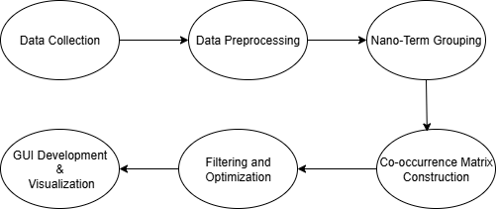
General Workflow

Slide 6
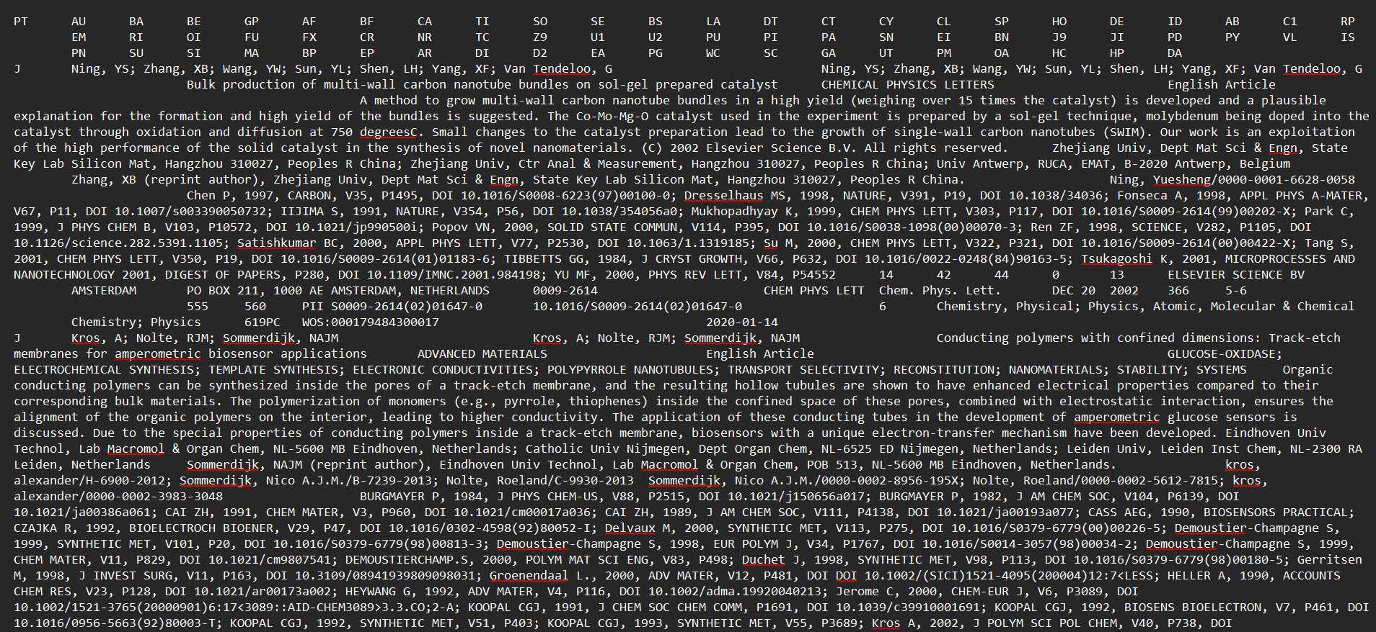
Data Collection
Initial Files Provided: 📁155 .txt files

Slide 7

Goal:
Convert multiple unstructured text files into a single structured Excel file for co-occurrence analysis.
Read
→ Open and decode each .txt file (UTF-16 / UTF-8)
Extract
→ Get column headers and corresponding data rows
Aggregate
→ Append data from all files into a unified column-wise structure
Export
→ Convert to DataFrame and save as a single Excel file
READ
EXTRACT
EXPORT
AGGREGATE

Slide 8
LIBRARIES :
OS → file navigation
PANDAS → data handling
PROCESS :
✅ Column Headers
→ It reads the first line of each file and splits it by tab \t to get the column names like PT, AU, TI, etc.
✅ Data Rows
→ It processes every other line after the header, splits them by tab, and stores each row as a list of values.

Slide 9
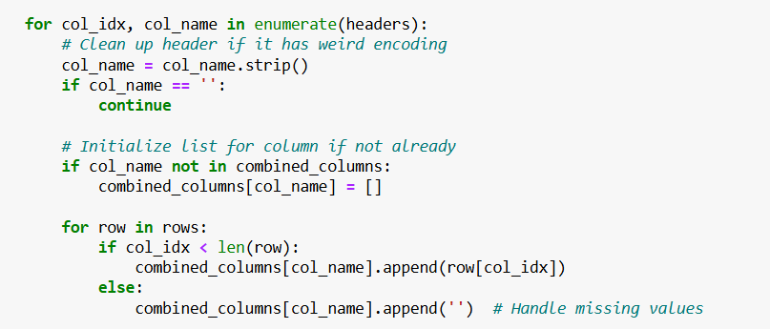
1. Loop through each column in the header row.
2. Clean column name
Removes extra whitespace or weird formatting.
Skips empty or unnamed columns.
3. Initialize storage
Creates a new list for the column in the combined_columns dictionary
If it already exists (from earlier files), skips initialization
4. Append values to the correct column
For each row:
If value exists at col_idx, add it to the column list
If value is missing, append an empty string ' ' to maintain alignment

Slide 10
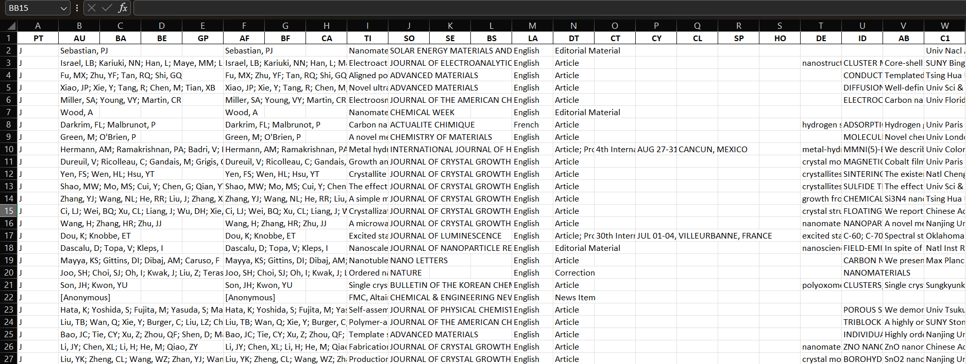
SNIPPET OF EXCEL
✅ Total Records (Rows): 72,950
✅ Total Attributes (Columns): 67

Slide 11
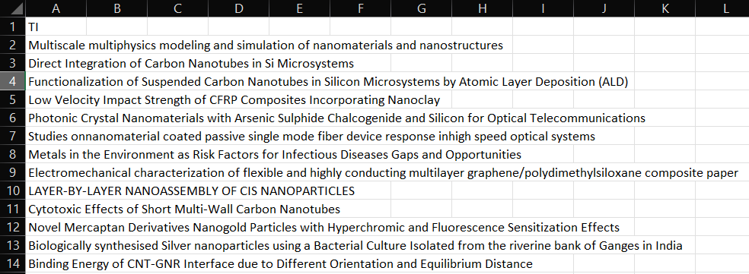


Phrase Extraction
SNIPPET
STEP - 1
LIBRARY - Pandas
Extract the specific column [TI]
Saved to a new Excel file
STEP - 2
ANALYSIS :
For Example :
Direct Integration of Carbon Nanotubes in Si Microsystems
Propagation Models for Nanocommunication Networks
Goal :
Remove English Stopwords and Nano-related Terms.
Extract the Meaningful Phrases. Save to a new excel file.

Slide 12
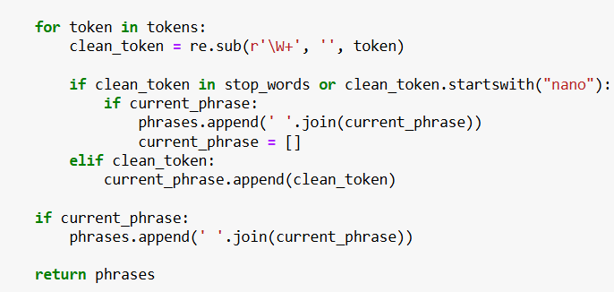
LIBRARIES :
pandas → For loading .csv files and saving results to Excel
re (Regular Expressions) → For cleaning and filtering tokens (e.g., removing punctuation)
nltk (Natural Language Toolkit) → For natural language processing:
->word_tokenize() – tokenizes titles into words
-> stopwords.words('english') – removes common English stopwords
Loop through each word (token) in the title
Clean the token using re (removes punctuation)
If token is a stopword or starts with "nano":
End current phrase (if any) and store it
Else:
Add the clean token to the current phrase
After the loop:
Add any remaining phrase to the final list
Return all extracted phrases
For example :-
Direct Integration , Carbon , Si Microsystems
Propagation Models, Networks

Slide 13
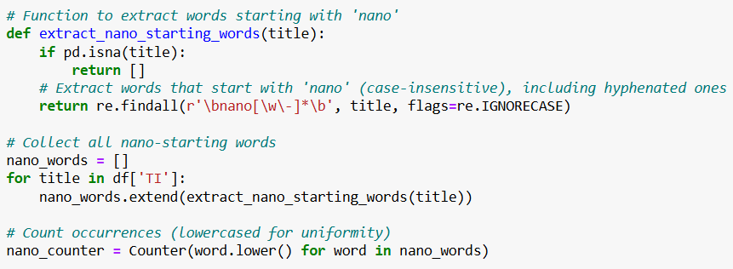
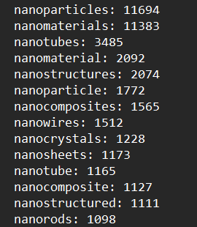

Nano Related Word Extraction
STEP - 1
LIBRARIES :
pandas → To read the Excel file and handle the TI column
re (Regular Expressions) → To find words starting with "nano" using a regex pattern
collections.Counter → To count the frequency of each extracted nano-word efficiently
Extracts words starting with "nano" (e.g., nanotube,
nano-particle)
\bnano[\w\-]*\b matches hyphenated and alphanumeric nano-words
A list of all nano-words + their frequency counts

Slide 14
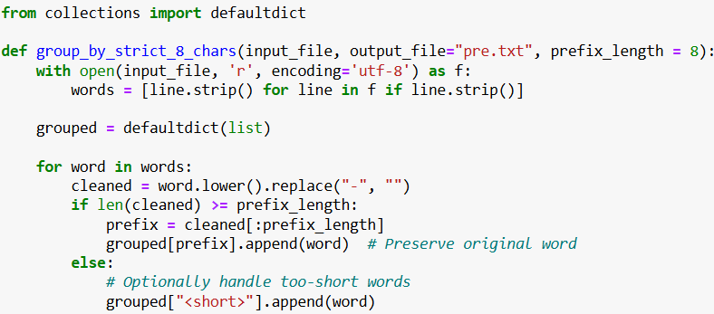
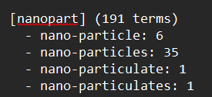
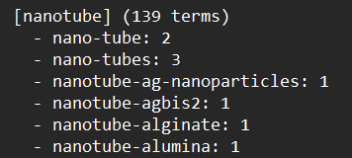
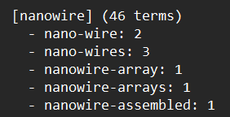
STEP - 2
Grouping Nano Terms by Prefix
Goal:
Group similar nano-words based on their first 8 characters :
Cluster similar variants (e.g., nanopart, nanoparticle, nanoparticles)
✅Total Groups: 885

Slide 15
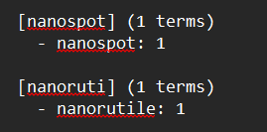
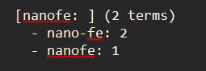
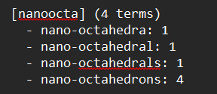
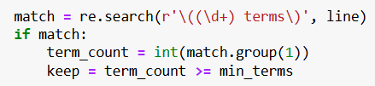
STEP - 3
Removing Small Groups
Goal:
Filter out less significant groups (with < 6 terms) to focus on frequently used nano-word clusters.
For Example : -
(Removing all such type of groups)
Used Regular Expression to identify group sizes and filter based on the min_terms threshold.
Keeping only those groups with ≥ 6 terms.
Finally saved a cleaned list of strong nano groups in a TXT file
✅Total Groups : 84!

Slide 16
Co-occurence Matrix
STEP -1
Goal:
To compute how frequently each phrase appears in titles that mention specific nano-term groups.
Matrix Construction:
Rows → Phrases
Columns → Nano groups
Cells → How many times the phrase co-occurred with that nano group
Matching Logic:
For each title, check if it contains any term from each nano group
If matched, increment the count for that phrase–nano group pair
Each title can match multiple nano groups

Slide 17

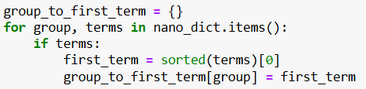
STEP -2
Load nano-groups from txt file
match_group = re.match(r"\[(.*?)\]", line)
Group name
match_term = re.match(r"-\s*(.+?):\s*\d+", line)
Nano-terms inside each group
For example :
Group = nanopart
Terms = {nanoparticle, nanoparticles, nano-particulate...}
group_to_first_term["nanopart"] = "nanoparticle"
Store the first alphabetical term from each group for labeling matrix columns

Slide 18
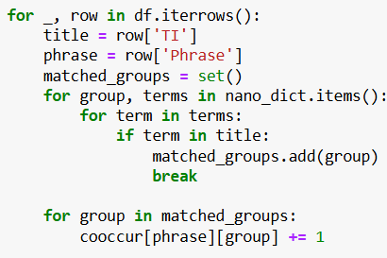
STEP - 3
Count co-occurrence of phrases with nano groups
Extracts title and phrase
Matches title with terms from nano groups
Counts co-occurrence for each phrase-group pair
STEP -4
Build the final matrix
Iterates over phrases and fills co-occurrence values for all groups
Creates row-wise data: [Phrase, Count1, Count2, ..., CountN]
Converts to DataFrame: Ready for Excel or visualization
Final structure: Phrase × Nano Group Matrix

Slide 19
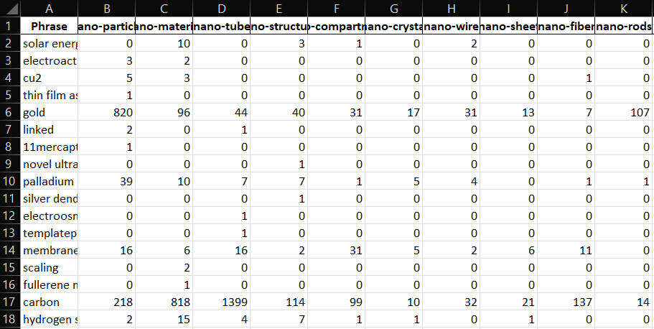
SNIPPET OF THE MATRIX
✅ ROWS : 97351
✅COLUMNS : 84

Slide 20
Matrix Simplification
Removing Verb-Containing Phrases →
For Example : use , using ....
Libraries :
Pandas →
For reading and writing Excel files, filtering rows using .apply()
nltk →
word_tokenize → To split each phrase into individual words (tokens)
pos_tag → To assign part-of-speech tags (like verbs, nouns, etc.) to each word
2. Row-Wise Filtering (Phrases):
Removed rows where the sum of co-occurrences = 1 ➝ very narrow context
Continued filtering with thresholds: sum ≤ 5, 10, ..., up to 100 →
Kept only phrases with broader relevance across nano-groups
3. Column-Wise Filtering (Nano-Term Groups):
Dropped columns (nano groups) with:
→ Very low frequency Or insignificant linkage to phrases

Slide 21
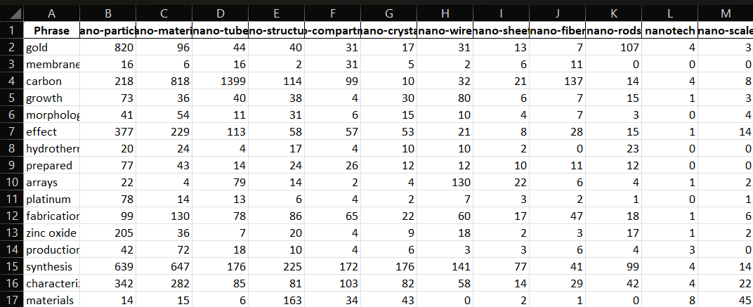
FINAL MATRIX
✅ ROWS : 130
✅ COLUMNS : 25

Slide 22
Interactive Visualization Graphical Interface
Libraries :
1. GUI Creation
tkinter – for building the interface
ttk, messagebox, filedialog – for enhanced widgets, dialogs, and file operations
2. Data Handling
pandas – for reading and manipulating Excel data
3. Visualization
matplotlib.pyplot – for plotting the network graph
networkx – for creating and managing the graph structure
FigureCanvasTkAgg – to embed matplotlib charts into the Tkinter GUI

Slide 23
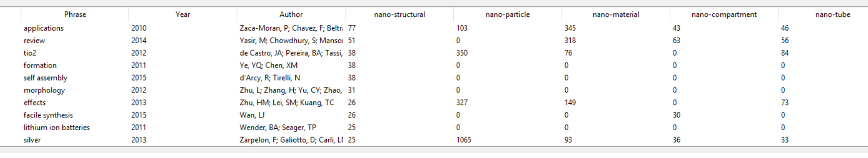
User Inputs
Nano-terms (e.g., nano , nan , nanomat , nano* , etc)
Year range (e.g., 2010–2020 , 2010-15 , 2007 to 2010)
Phrase limit (e.g., Top 10 phrases or all)
Display Table Output
Shows phrases, year, author, and co-occurrence values in an interactive table

Slide 24
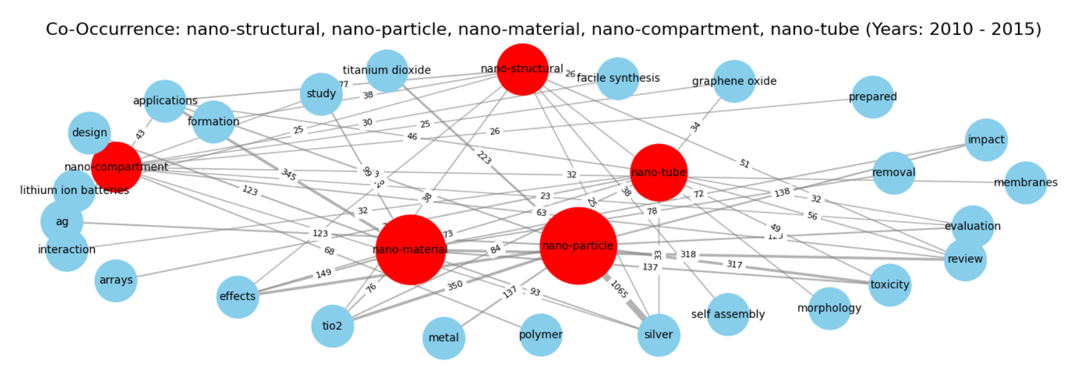
Generate Network Graph
Dynamically creates a cluster graph using NetworkX
Phrase–nano-term edges are weighted by co-occurrence count
Nodes sized by global relevance
Provides option to export the visual graph

Slide 25
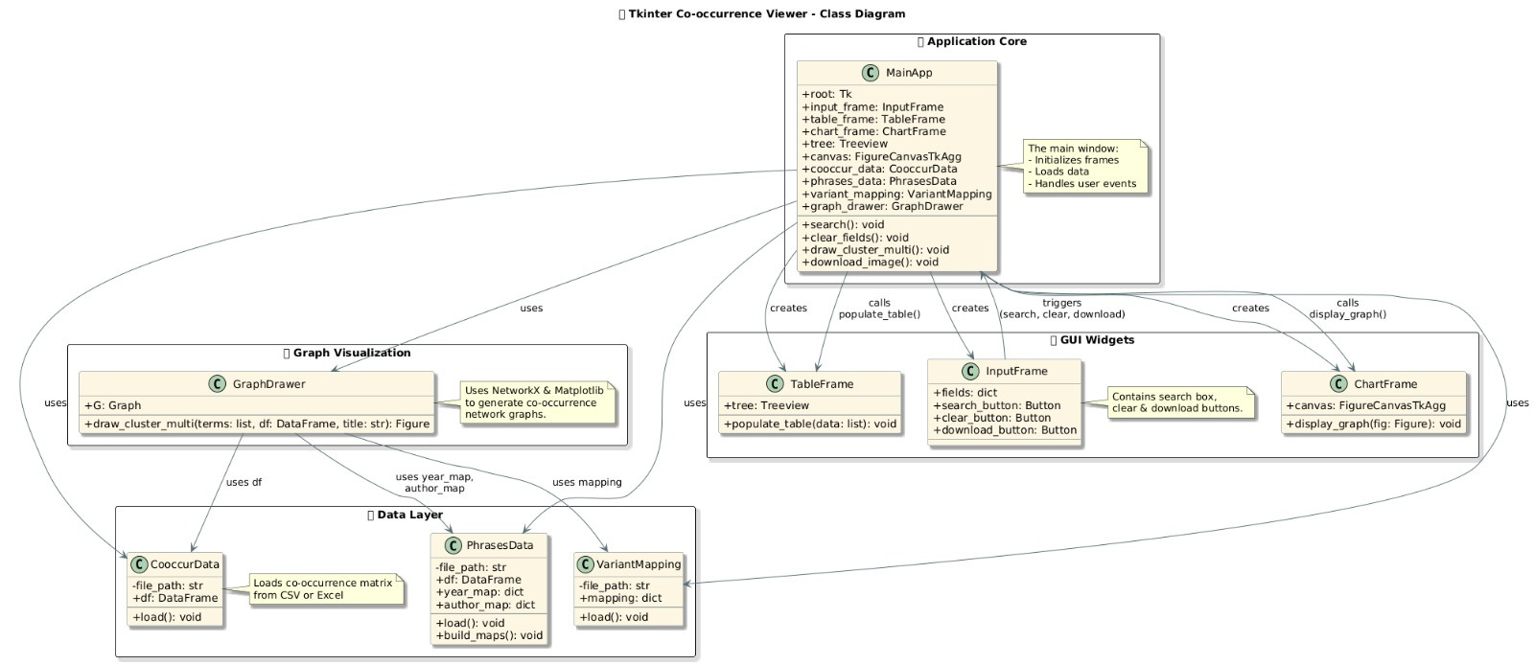
WORKFLOW

Slide 26
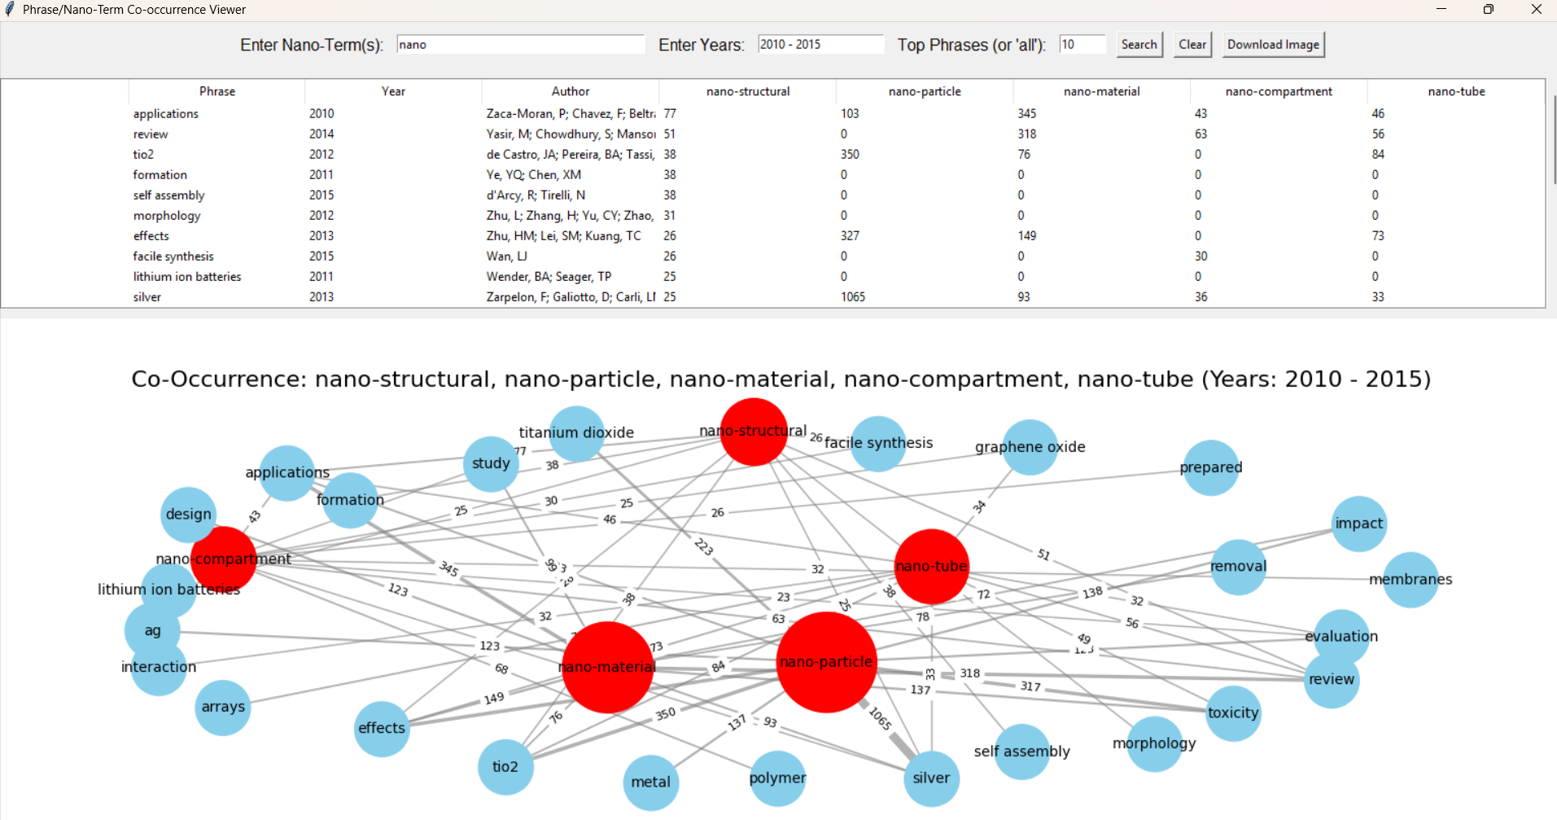
"Nano-Term and Phrase Co-occurrence Viewer"

Slide 27
Challenges
Handling Term Variants
Mapped diverse forms of nano-related words (e.g., nanotube, carbon nanotubes) to unified categories for consistent analysis.
Verb Phrase Filtering
Applied Natural Language Processing (NLP) techniques to eliminate phrases containing verbs, ensuring only noun-based scientific terms were retained.
Co-occurrence Matrix Optimization
Dealt with a large, sparse matrix by filtering rows and columns based on frequency thresholds to improve clarity and performance.
Graph Visualization Complexity
Managed the challenge of plotting large and weighted phrase-nano term networks with readable node sizes and edge labels.
Dynamic User Input Handling in GUI
Developed a responsive Tkinter-based interface that correctly interpreted various user inputs like partial terms, year ranges, and custom filters.

Slide 28
Conclusion
This project effectively mapped the co-occurrence between scientific phrases and nano-related terms, enabling a structured exploration of nano-science literature. By incorporating data cleaning, variant grouping, verb elimination, and frequency-based filtering, the approach ensured accurate and relevant associations. The development of an interactive GUI further empowered users to analyze nano-term linkages across specified timeframes and visualize results dynamically. Overall, the project successfully integrated text mining and data visualization, offering a valuable research-support tool for identifying trends and patterns in nano-scientific studies.

Slide 29
References
Pandas Documentation – Data manipulation and Excel file handling
https://pandas.pydata.org/docs
Python re Module – Regular expression operations for text processing
https://docs.python.org/3/library/re.html
NetworkX – Network Analysis in Python
https://networkx.org/
NLTK – Natural Language Toolkit for Text Processing
https://www.nltk.org/
Tkinter – Python Interface to Tcl/Tk for GUI Development
https://docs.python.org/3/library/tkinter.html
VOSviewer – Visualizing Scientific Landscape and Bibliometric Networks
https://www.vosviewer.com/
ChatGPT – OpenAI’s Conversational AI Model
https://openai.com/chatgpt

Slide 30


